Slide 1
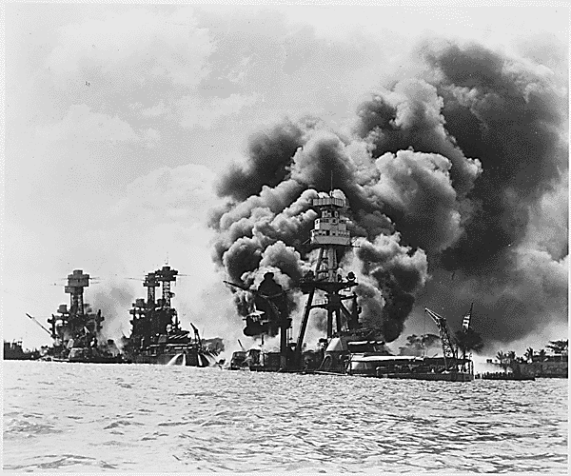
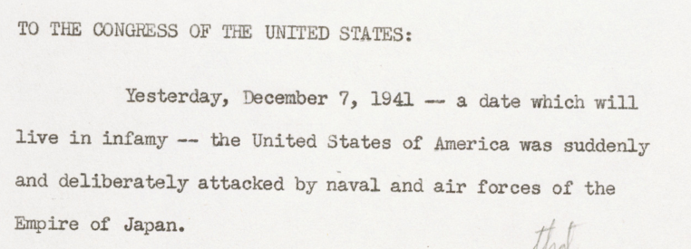
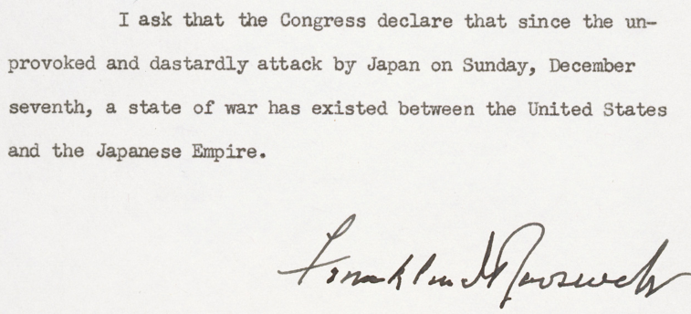
Pearl Harbor Bombed
December 7, 1941
The Imperial Japanese Navy Air Service attacks the American naval base at Pearl Harbor, Hawaii. The U.S. declared war on Japan the next day.
Excerpts from President Franklin D. Roosevelt's speech to congress on the day following Japan's attack prompted the U.S. joining the Allied war against the Axis powers of Germany, Japan, and Italy.
The USS Arizona (right) was one of eighteen ships sunk or severely damaged during the bombing of Pearl Harbor.

Slide 2
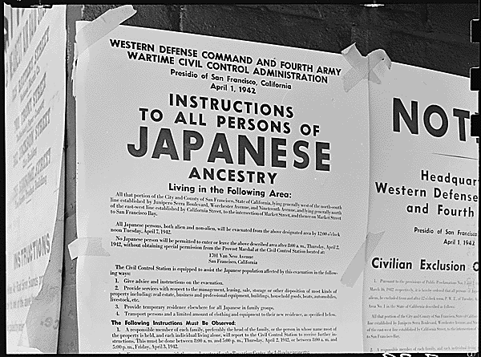
Executive Order 9066
February 19, 1942
President Franklin D. Roosevelt signs Executive Order 9066 leading to the forced removal of Japanese immigrants and Japanese Americans from large areas along the West Coast. These areas known as "exclusion zones” were designated by the U. S. military and covered most of California, Oregon, and Washington, along with parts of Arizona and the territories of Hawaii and Alaska.
Executive Order 9066 was the result of a long history of anti-Asian policies on America's west coast combined with unsupported fears of a pending Japanese invasion.
A copy of the exclusion order for those of Japanese ancestry posted at First and Front streets in San Francisco.

Slide 3
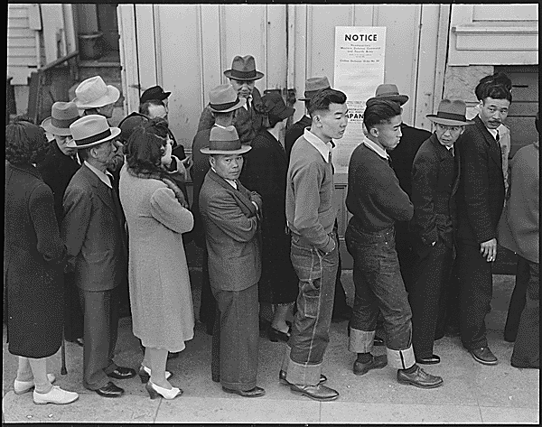
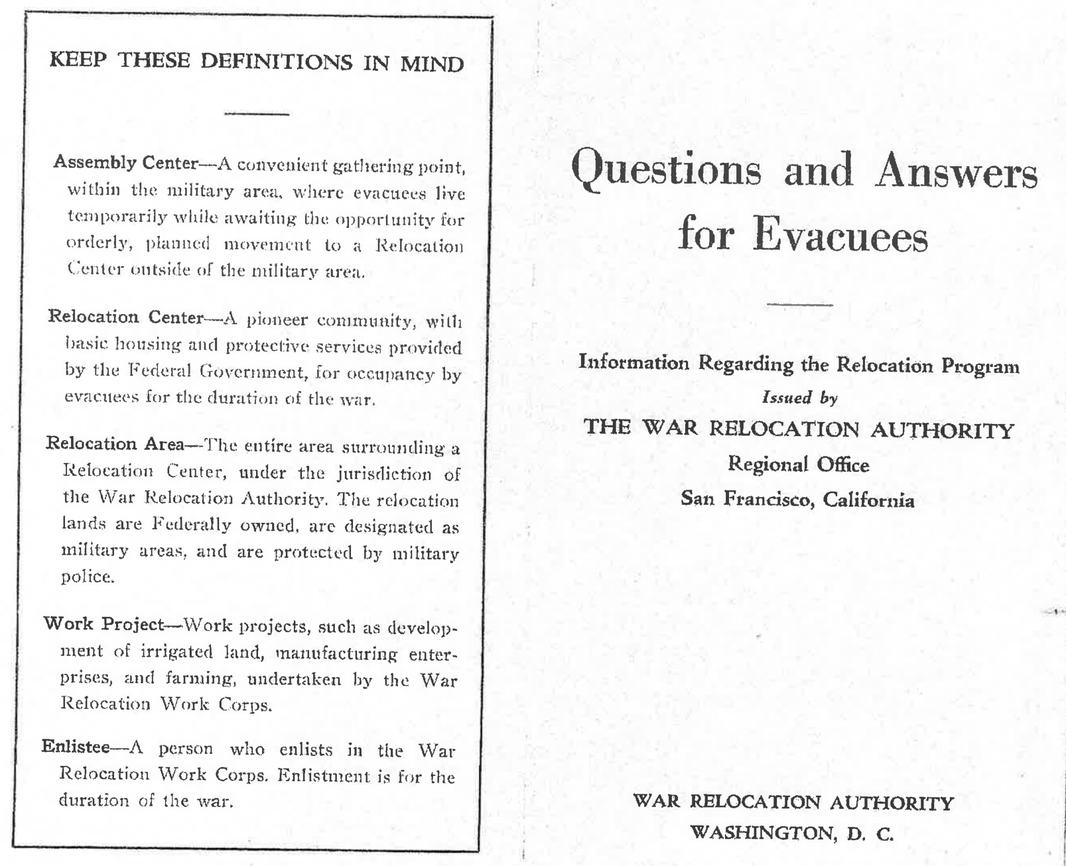
Executive Order 9102
March 18, 1942
President Franklin D. Roosevelt signs the executive order that establishes the War Relocation Authority (WRA) to oversee the forced removal and incarceration of Japanese Americans.
All people with Japanese ancestry living within the exclusion zone were forced to register with the WRA.
This WRA pamphlet was given to all people with Japanese ancestry living within the exclusion zone to explain rules and conditions of evacuation and incarceration.

Slide 4
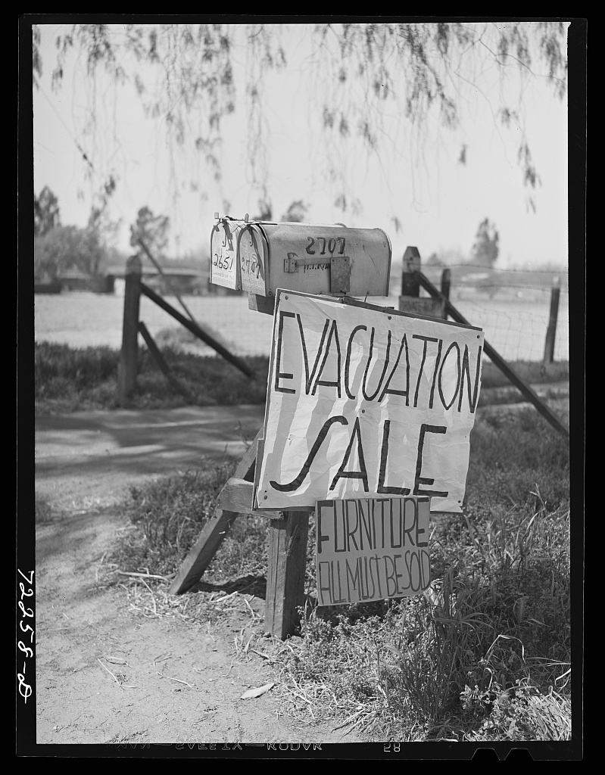
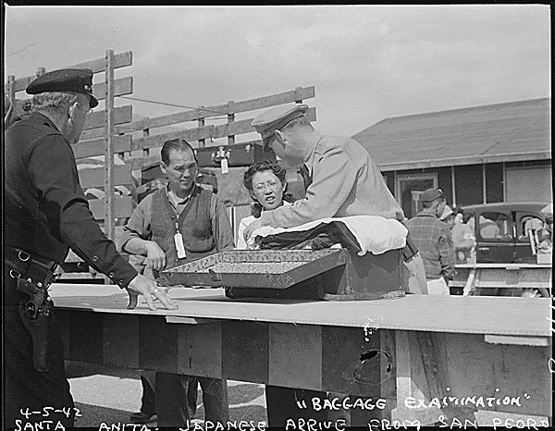
Japanese Evacuation Begins
March 29, 1942
Japanese Americans bound for incarceration were forced to sell their property and most of their possessions. Incarcerees were subject to luggage inspections upon arrival at the temporary detention centers.

Slide 5
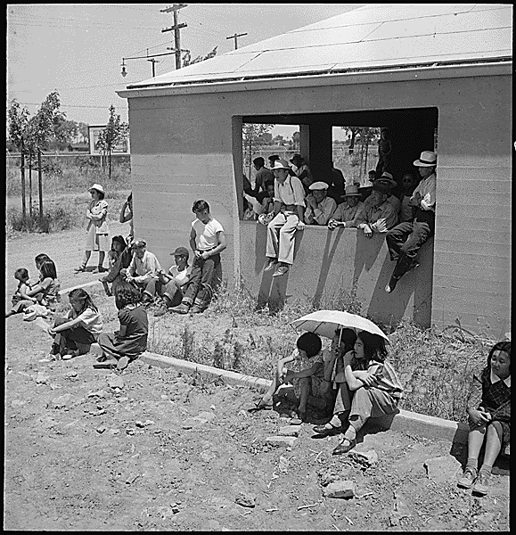
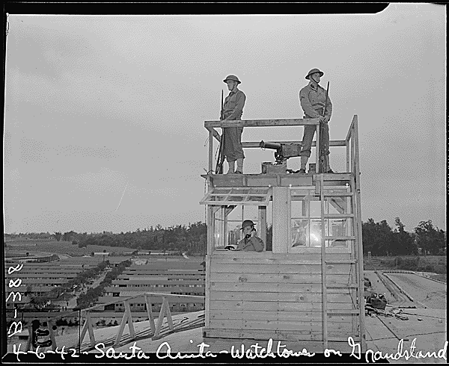
Life in Makeshift "Assembly Centers"
Spring 1942
Acting under the authority of Executive Order 9066, Lieutenant General John L. DeWitt of the U.S. Army’s Western Defense Command ordered the forced removal of people of Japanese ancestry from their homes along the Pacific Coast. The newly created War Relocation Authority (WRA) oversaw the process, sending Japanese Americans to fifteen temporary detention sites - euphemistically called “assembly centers” by the U.S. government - often set up at fairgrounds and racetracks. Families were held there for several months while more permanent concentration camps were being built.
Makeshift detentions centers provided few amenities or distractions for incarcerees during the summer of 1942. Despite their many shortcomings, incarcerees generally regarded the conditions at the concentration camps as a marked improvement over that at the temporary detention sites.
Incarcerees were kept under armed guard at the temporary detention sites, including the converted horse racetrack Santa Anita shown here.

Slide 6
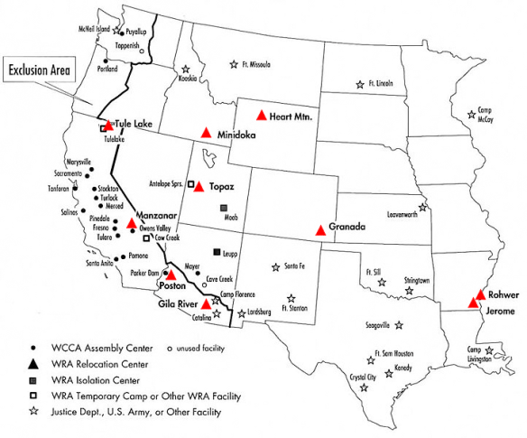
Ten "Relocation Centers" Established
Summer 1942
The newly formed War Relocation Authority (WRA) directed the site selection and creation of the ten camps. Each had a large amount of federally owned land that was remote yet accessible by rail.

Slide 7
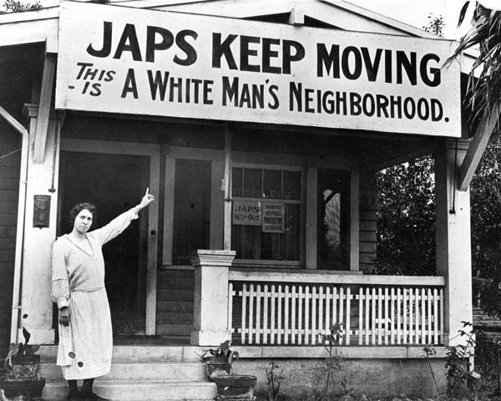
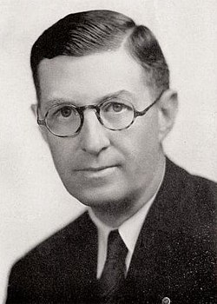
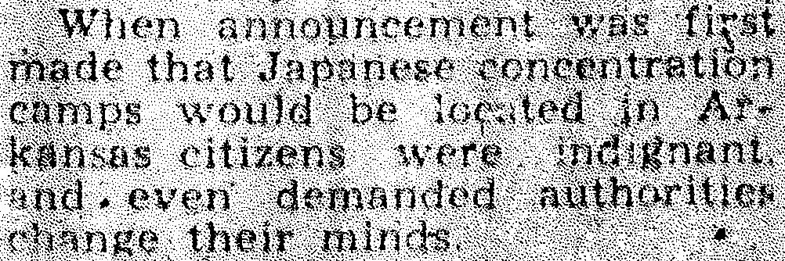
Arkansas Initially Refuses Camps
May-June 1942
Pre-WWII anti-Japanese sentiments and laws in California combine with fear and Jim Crow racism in Arkansas. Backed by popular support, Governor Homer Adkins initially refuses WRA plans for concentration camps in the state. He eventually concedes when the War Department agreed to:
Maintain strict military control.
Prohibit Japanese competition with Arkansas labor.
Prevent them from purchasing land in Arkansas.
Remove them from the state immediately after the war.
(Left) Arkansas governor Homer Adkins (1941-1945)
(Right) Anti-Japanese sentiments in California c. 1920
(Lower right) The McGehee Times, June 25, 1942

Slide 8
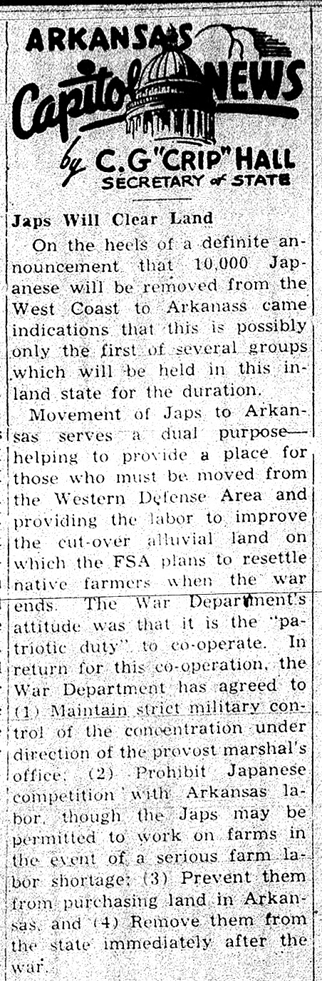

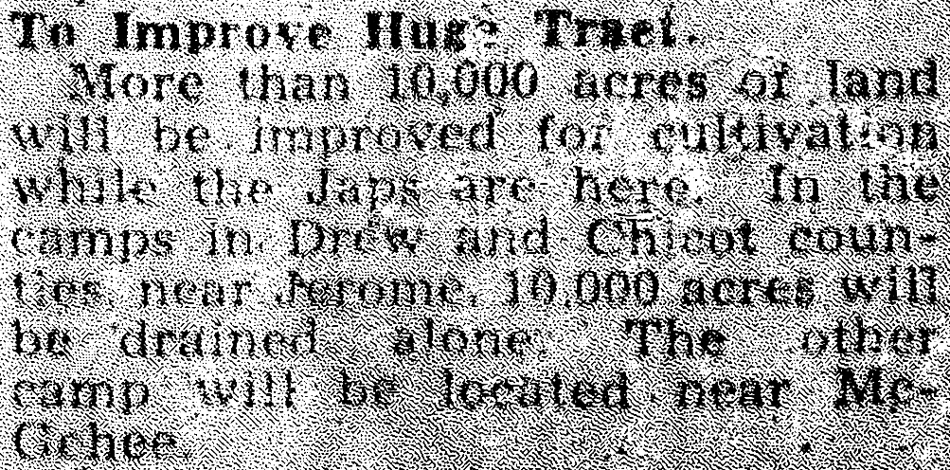
"Japs Will Clear Land"
June 1942
Arkansas newspapers announce plans for the Rohwer and Jerome concentration camps. These camps were brought to Arkansas on the promise of creation of more than 20,000 acres of farmland. The federal government used this incentive as a bargaining tool with Arkansas, as fear and racial prejudice initially caused the state to reject the War Relocation Authority’s proposal for two camps.
The Eudora Enterprise, June 11, 1942
The McGehee Times, June 25, 1942

Slide 9
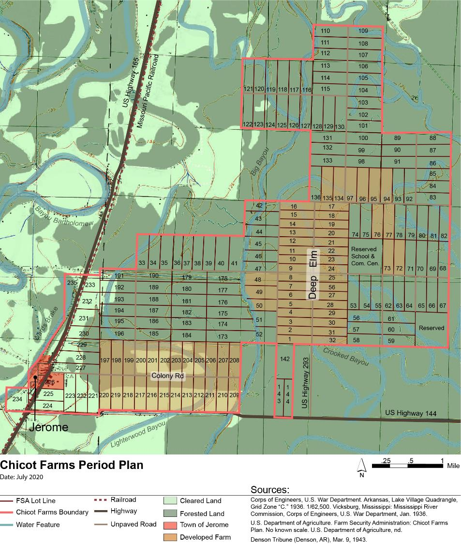
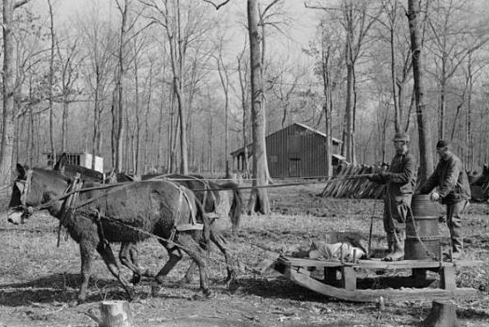
New Deal FSA Lands Converted to Camps
1937-1942
The creation of new agricultural land in southeast Arkansas had already been attempted. Beginning in 1937, thousands of acres of lowland forest had been allocated by the Farm Security Administration as New Deal farming communities at Jerome and Rohwer. Some initial progress was made at Chicot Farms, which included the former logging village of Jerome, but frequent flooding and stubborn hardwoods made homesteading extremely difficult.

Slide 10
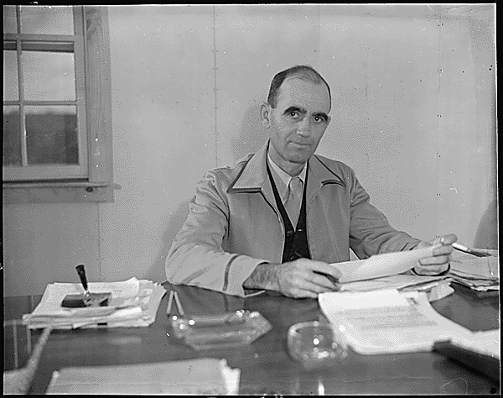
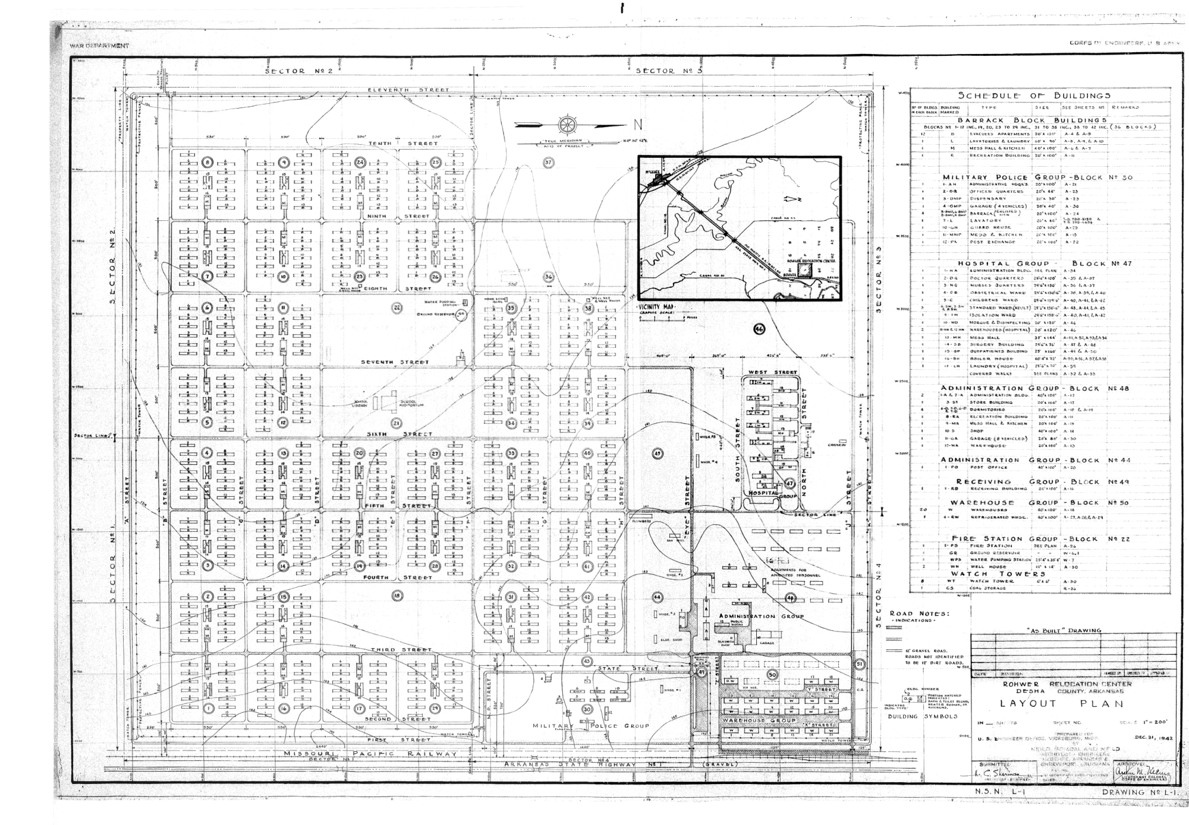
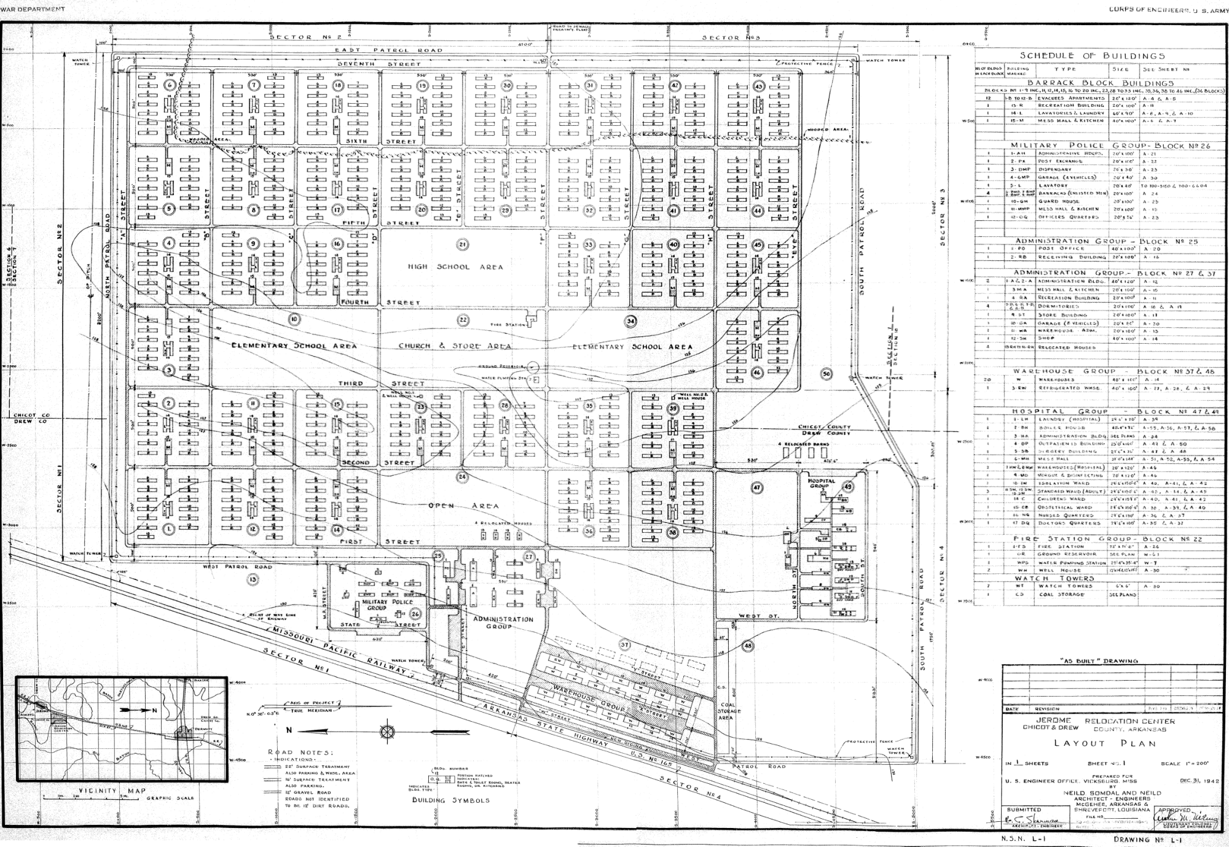
Concentration Camp Construction Begins
July 1942
Construction on the camps begins under the supervision the WRA camp directors and the US Army Corps of Engineers. Linebarder-Senne Construction Company of Little Rock is the lead contractor for the camp at Rohwer, while the contractor for Jerome is the A. J. Rife Construction Company out of Dallas, Texas. The WRA selected Arkansan and former FSA employee Ray D. Johnston to serve as the director of the Rohwer concentration camp.
As-built site plans for the Rohwer (left) and Jerome (right) camp cores.

Slide 11
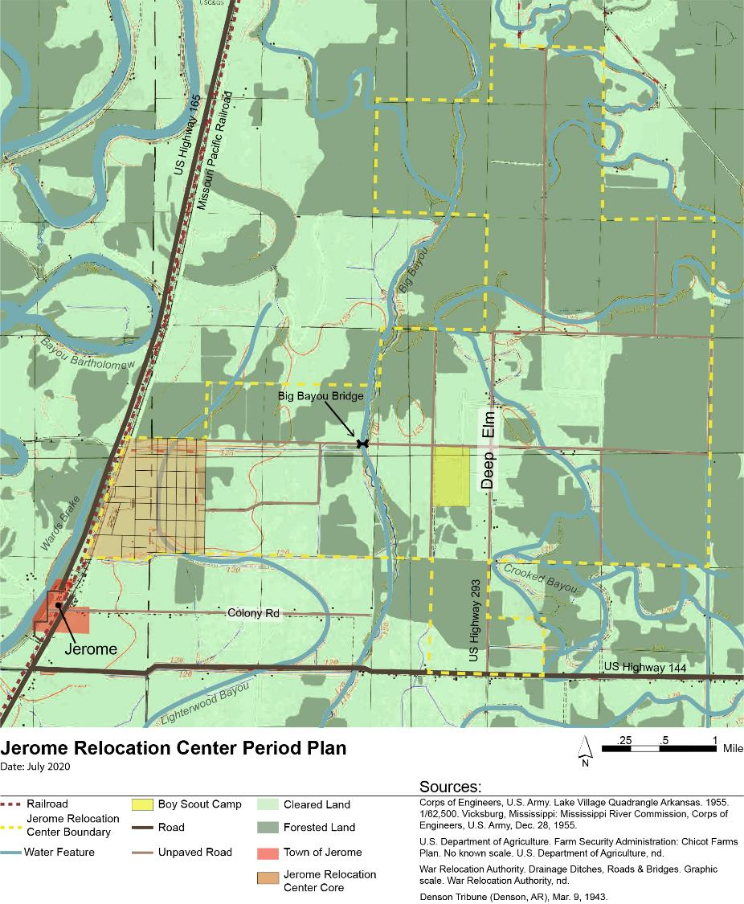
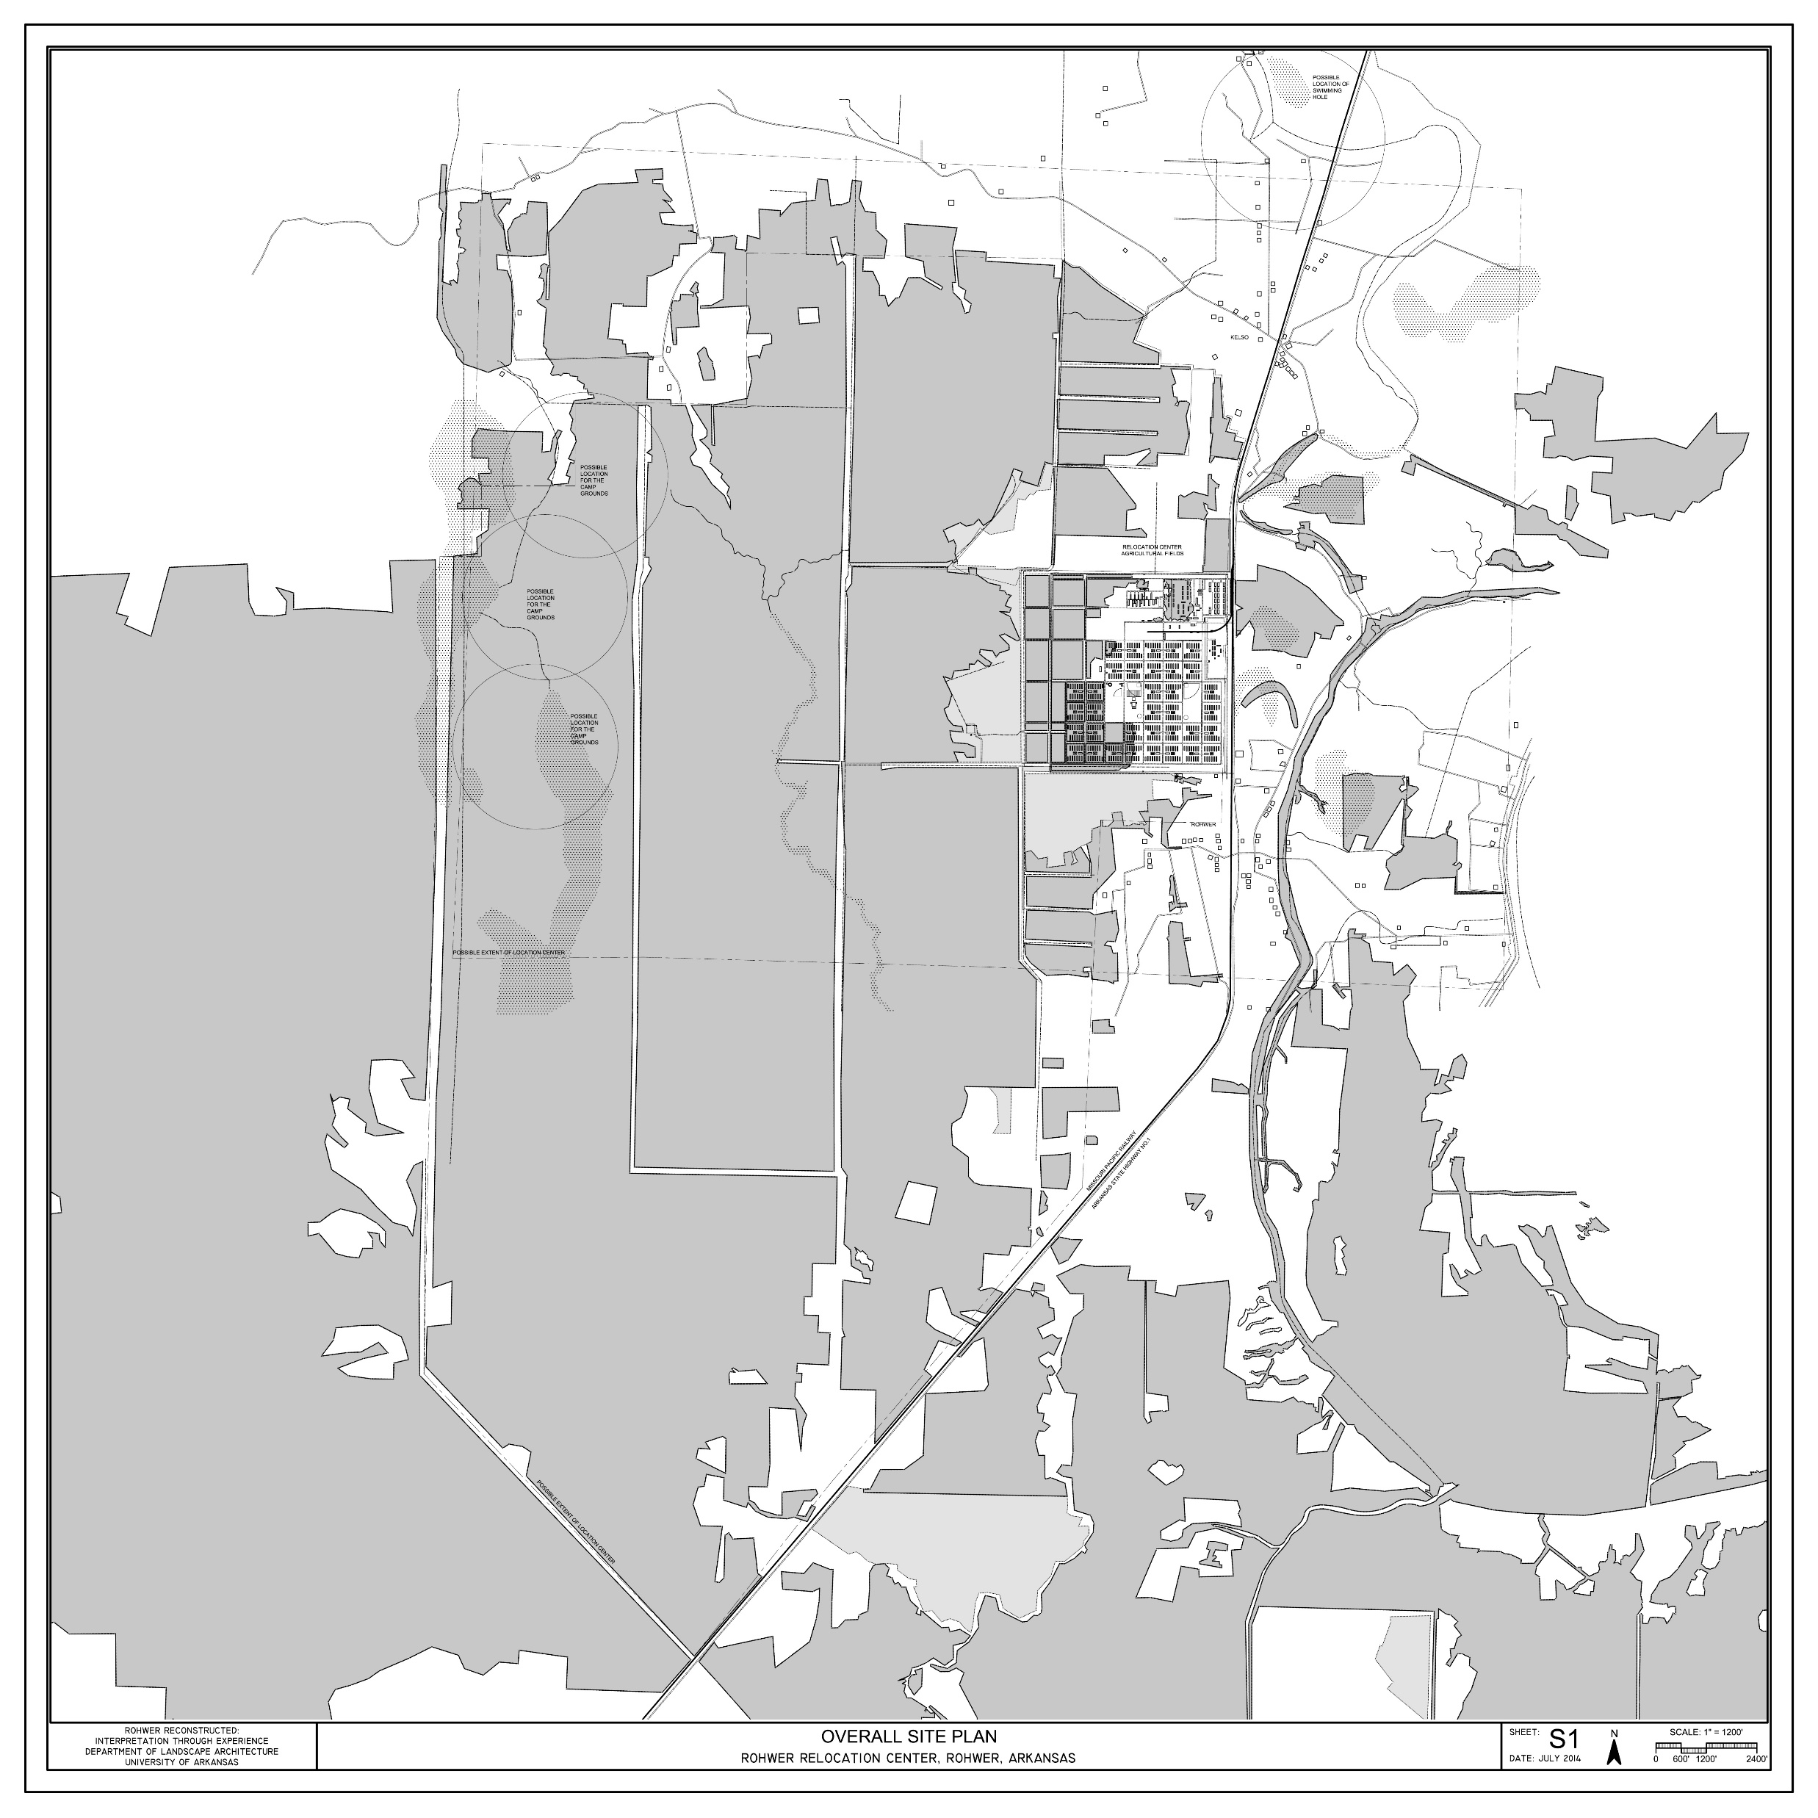
Notes:
In early 1942, the War Relocation Authority saw these large tracks of federal land that were remote yet accessible by rail as prime locations for concentration camps. While today we tend to think of these camps as only the 500-acre residential cores, the actual boundaries included thousands of acres of former Farm Security Administration lands that the Japanese American incarcerees were tasked with preparing for agriculture.

Slide 12
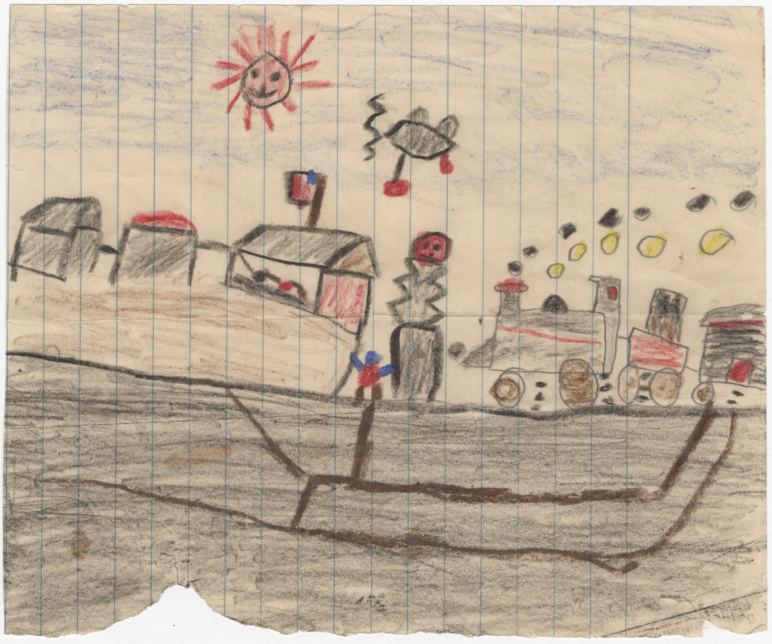
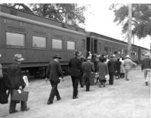
Incarceration Begins at Incomplete Camps
September 1942
The majority of incarcerees sent to the Rohwer and Jerome concentration camps were sent by train from the Santa Anita, Fresno, and Stockton temporary detention facilities, although families sent to Jerome from Hawaii were temporarily held at the Immigration Station in Honolulu.
Boarding the train at Santa Anita, 1942
A child's crayon drawing depicting the arrival of incarcerees at Rohwer concentration camp.

Slide 13
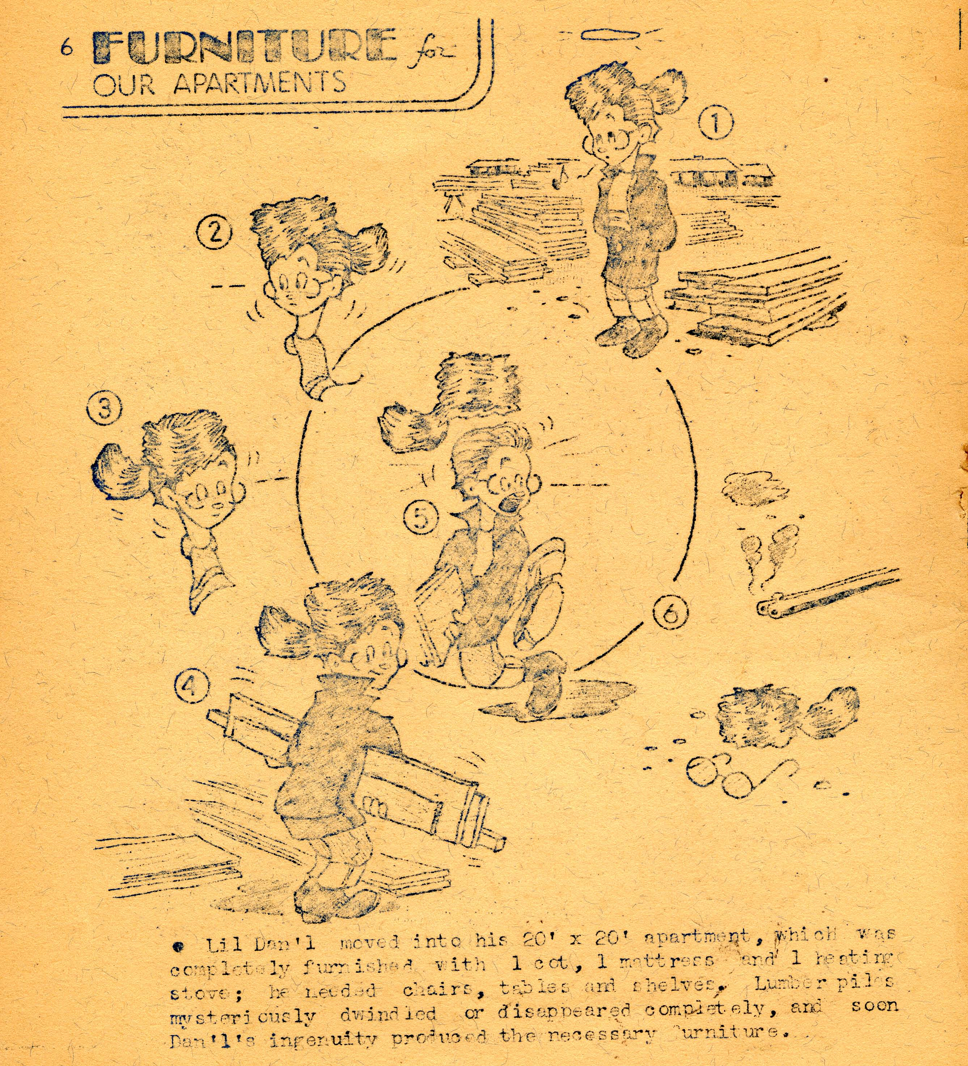
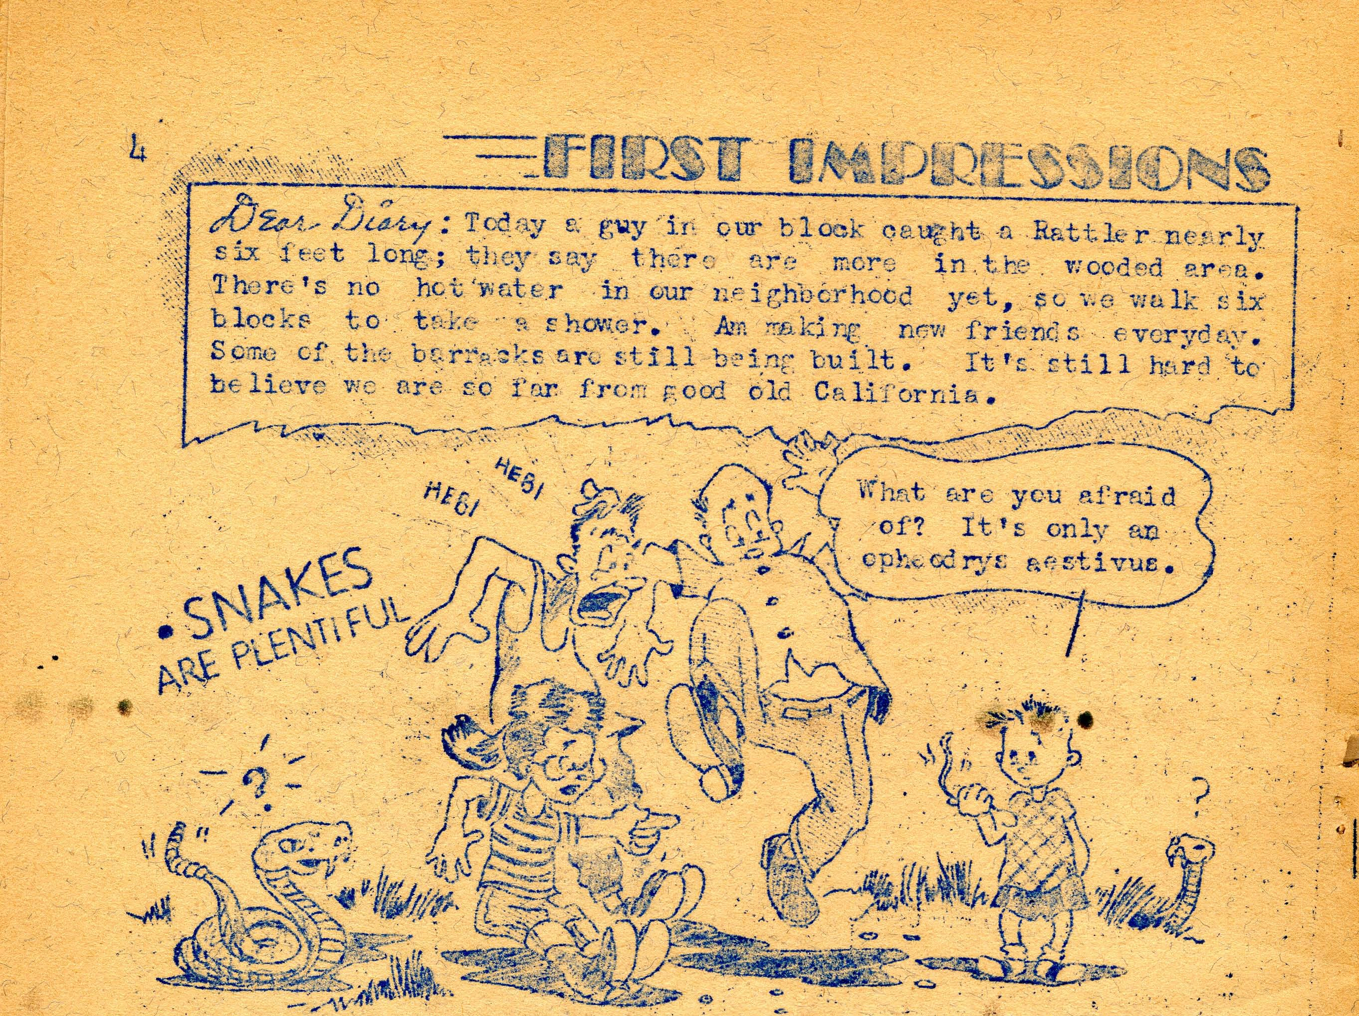
Early Struggles
Fall 1942
The new camp had to cope with numerous challenges. The flat bare earth, stripped of most vegetation during construction, became extremely muddy during rains. Boardwalks and gravel paths are installed to help alleviate the problems. Barrack apartments were only furnished with beds and a stove, leaving incarcerees to improvise as they sought to improve their living conditions. Scrap lumber piles left over from ongoing construction were rapidly depleted by incarcerees to make shelves, interior partitions, and furniture.

Slide 14
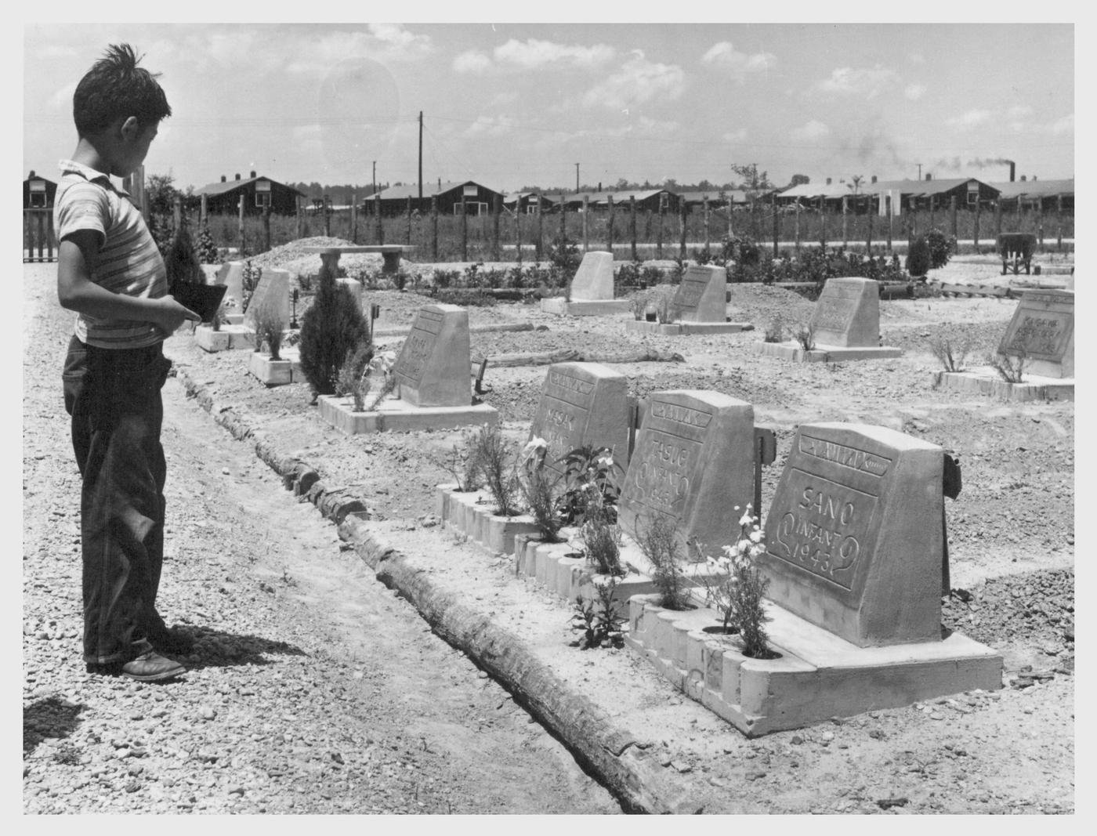
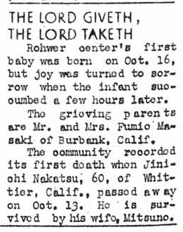
Rohwer Cemetery Established
October 1942
A small plot of land just outside the main Rohwer camp fence was set aside for burials after the birth and death of the camp's first baby.
Spearheaded by incerceree Koheiji Horisawa, the cemetery was expanded gradually to include twenty-four concrete headstones and two large concrete monuments by Rohwer's closure in late 1945.

Slide 15
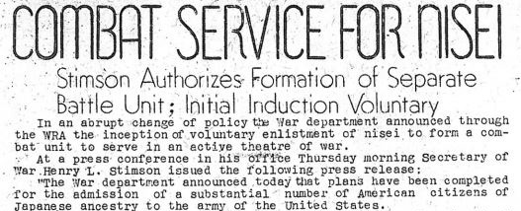
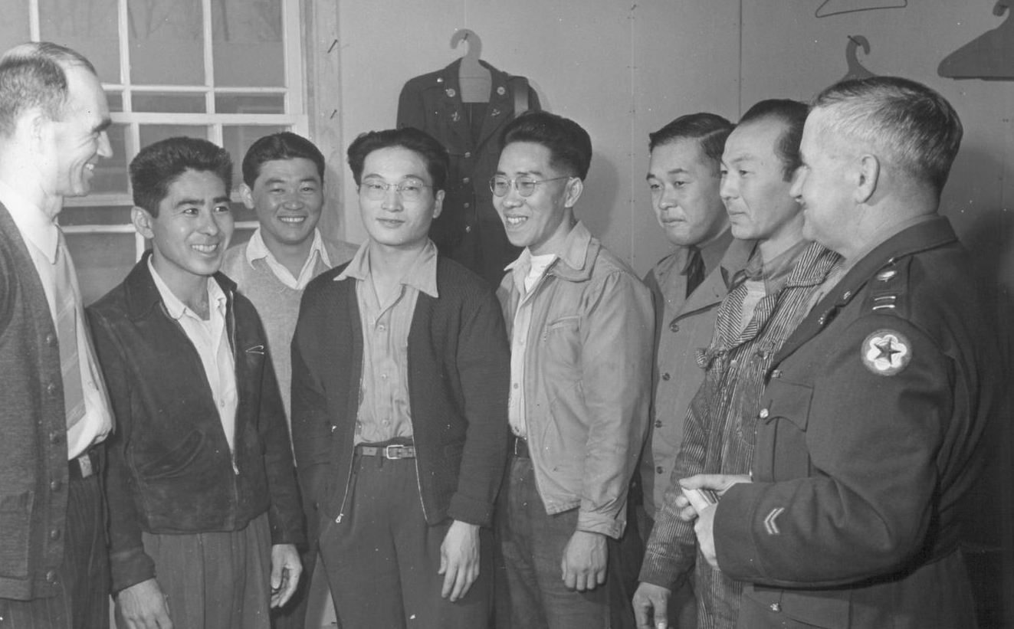
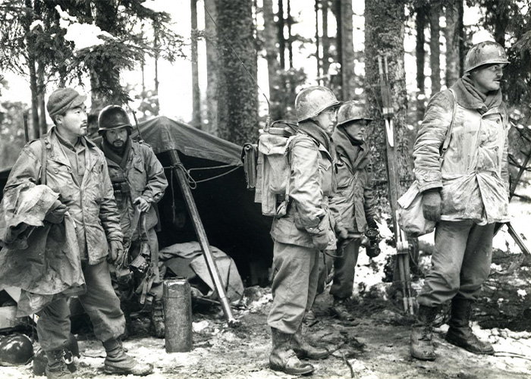
Japanese Volunteer Combat Team Announced
January 30, 1943
Rohwer and Jerome newspapers publish Secretary of War Henry Stimson's announcement of the creation of a volunteer combat team to be comprised of Japanese Americans, reversing an earlier decision. More than 33,000 Japanese Americans served in segregated units including the 100th Infantry Battalion and the 442nd Regimental Combat Team in Europe, which became the most highly decorated unit of its size in U.S. military history.
Rohwer director Ray D. Johnson (left) and Captain John A. Holbrook discuss recruitment with a group of incarcerees and Sergeant Isamu Adachi.
Members of the 442nd Regimental Combat Team, Vosges Forest, France, October, 1944

Slide 16
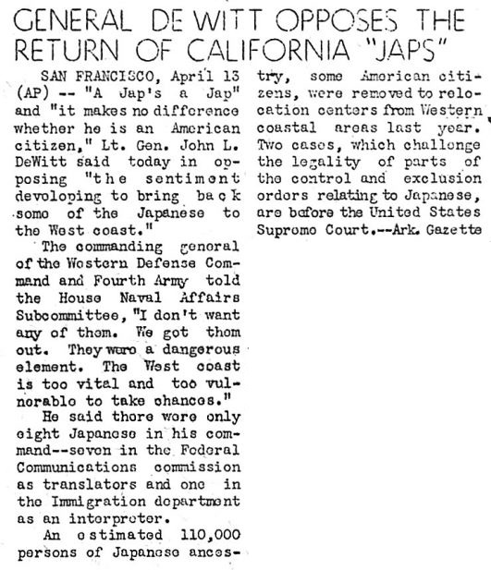
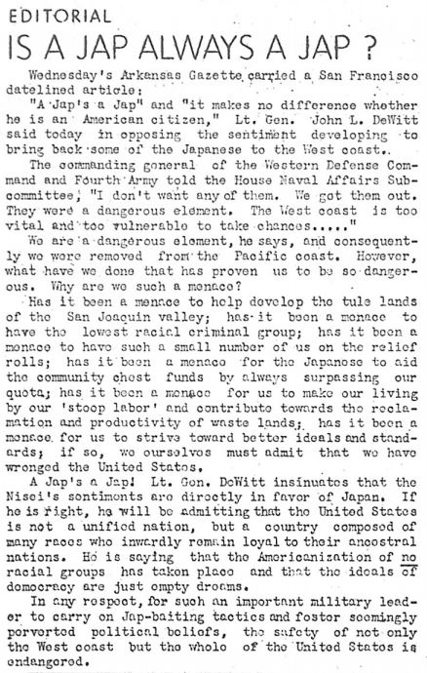
"A Jap's a Jap"
April 17, 1943
Many incarcerees were deeply hurt and angered when they hear about Lieutenant General John L. DeWitt statement of "a Jap's a Jap" while testifying to a congressional subcommittee about Japanese Americans serving in the military. DeWitt led the U.S. Army's Western Defense Command in 1942 and played a direct role in the forced removal and incarceration of Japanese Americans. The word “Jap,” a shortened form of “Japanese,” was a common racial slur during World War II and a constant reminder of the prejudice that Japanese Americans faced.

Slide 17
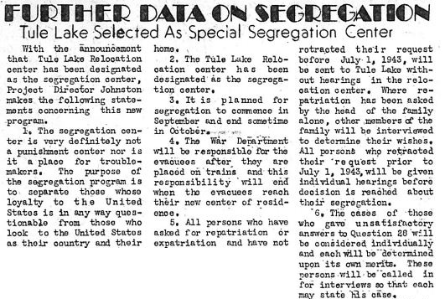
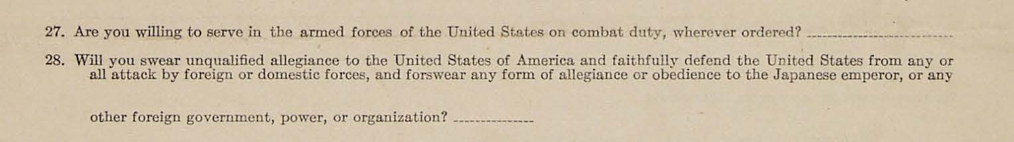
Assessing Loyalty and "Segregation"
July 1943
In July 1943, the government distributed the "Loyalty Questionnaire" across the camps with the intention of assessing individual's loyalty to the U.S. government. The last two questions on this 4-page survey (27 and 28) were poorly worded and created confusion and anger among many incarcerees, but they were also the ones used to trigger additional segregation measures. Those who answered "No" to either or both questions were categorized as "disloyal" and were to sent to the Tule Lake Segregation Center in California, where they were not allowed self-governance or leave.

Slide 18
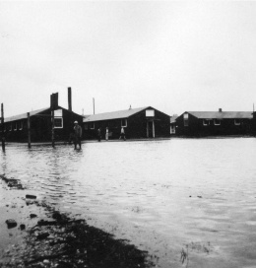
Life While Incarcerated: Hardship
1942 – 1945
Dislocation, removal, and severe racism
Loss of property, livelihoods, professional standing, and legal and financial jeopardy
Radical change in living conditions
Disruption of family life and traditions
Mud, cold, hot, snakes, mosquitoes
Severe stress of confinement, including social tensions between groups
Fighting and riots, resulting in some being jailed and incidents of self-harm
Still Americans with family fighting a war.
Flooded conditions at Rohwer concentration camp, Arkansas, c. 1942

Slide 19
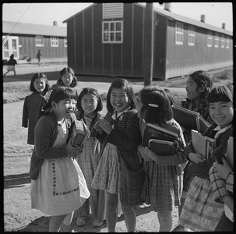
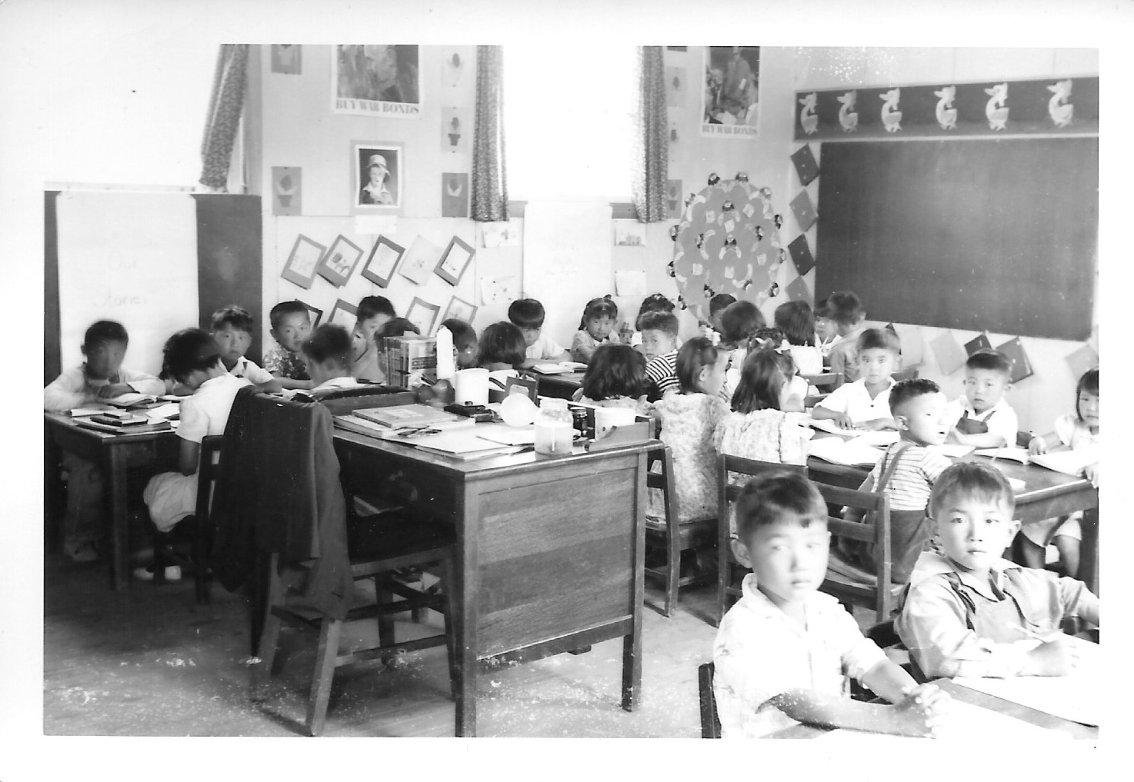
Life While Incarcerated: Education
1942 – 1945
Despite a shaky start due to delays in construction and the delivery of supplies, the WRA and incarcerees made the camp’s schools a top priority. Competition for better pay than the area’s public schools meant that the WRA was able to recruit some of the best teachers in the region. Schools at both camps included a nursery, kindergarten, two elementary schools, and a junior high and high school. Many students later reflected positively on their experiences in the camp’s schools, despite other extreme hardships of incarceration.

Slide 20
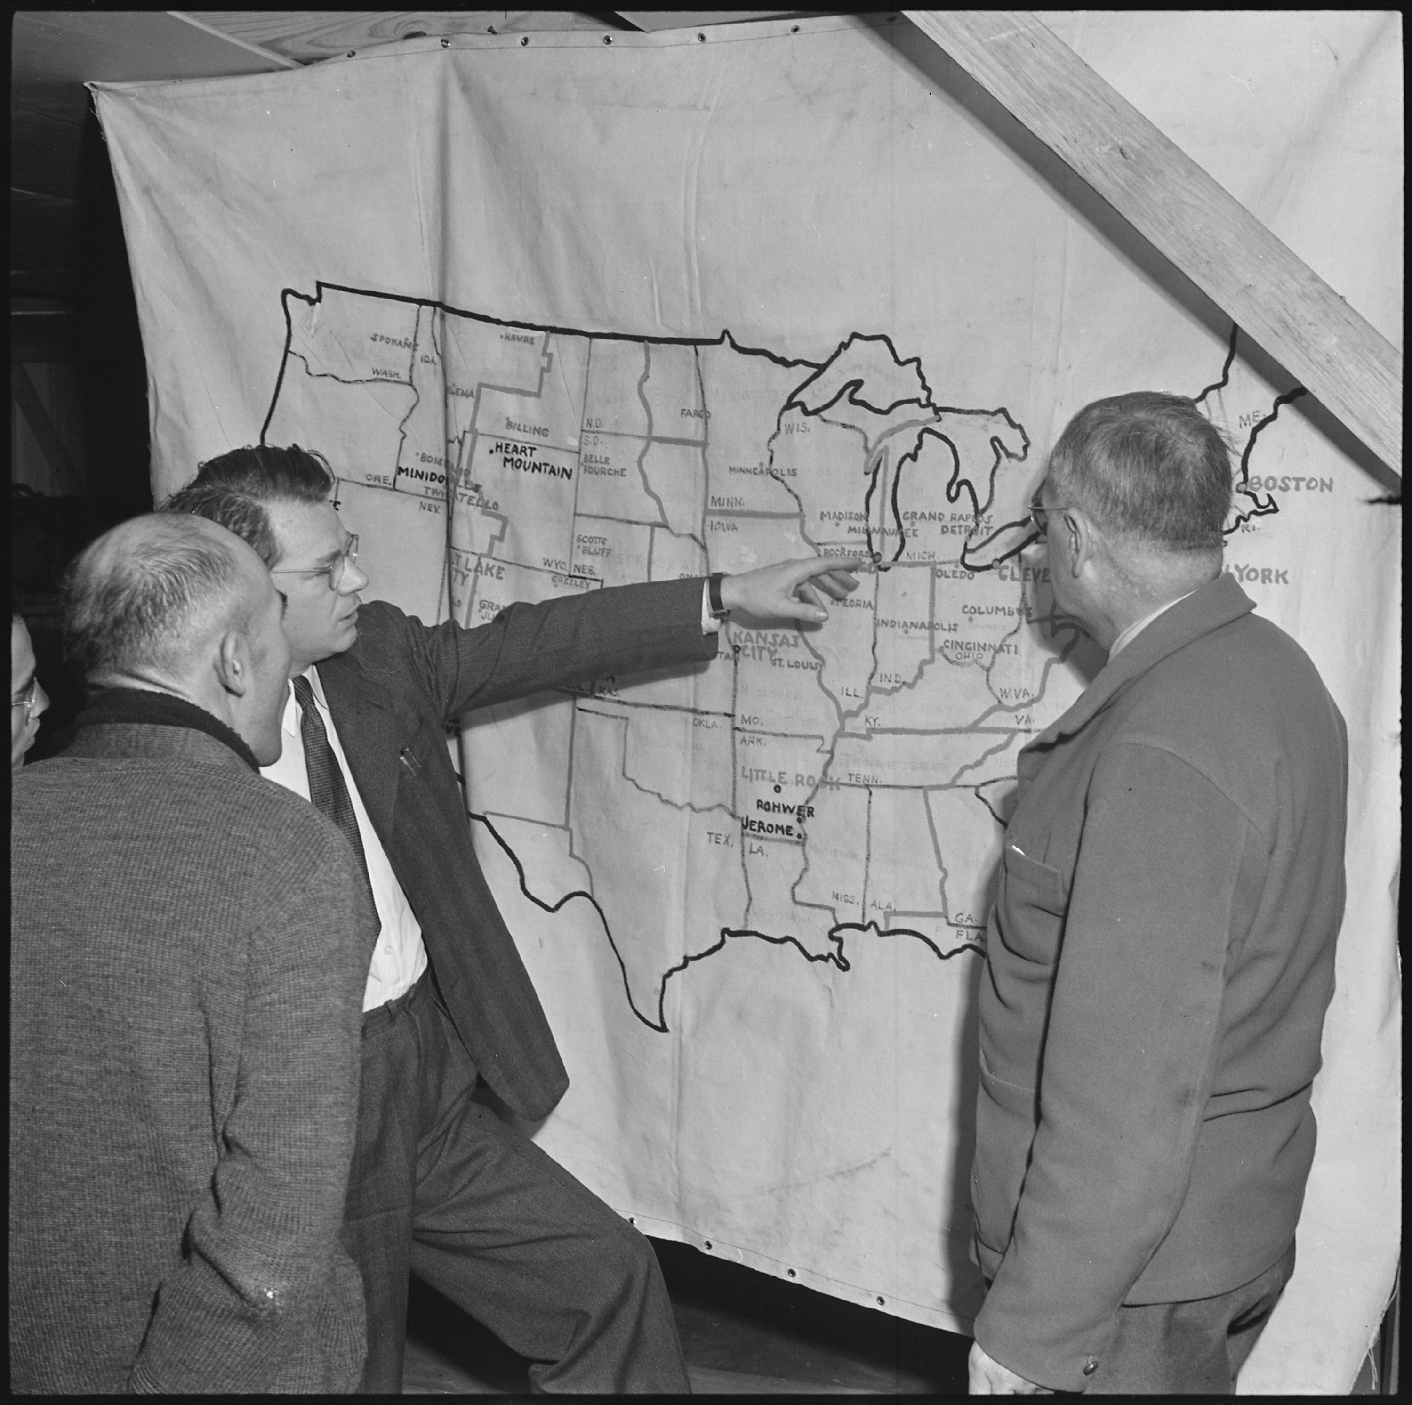
Life While Incarcerated: Dispersion
1942 – 1945
The underlying goal of Japanese American forced evacuation, incarceration, and relocation was to break up tightknit communities living on the West Coast and force a diaspora. The WRA allowed, and even encouraged, incarcerees to leave the camps, but only if specific conditions were met. Incarcerees could gain permission for temporary leave for field trips, work assignments, shopping, short-term employment in other states, and other similar situations. The WRA allowed transfers to one of nine other incarceration camps upon request. The WRA strongly encouraged permanent relocation to other states and granted indefinite leave to incarcerees who found long-term employment or enrolled in a college or university.
Harold Fistere and Elmer Shirrell, relocation supervisors, talk with a Rohwer incarceree about an opportunity to permanently relocate to Chicago for work. December 9, 1943.

Slide 21
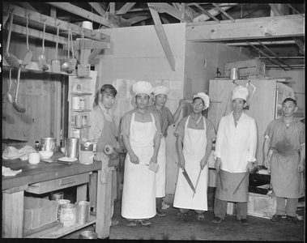
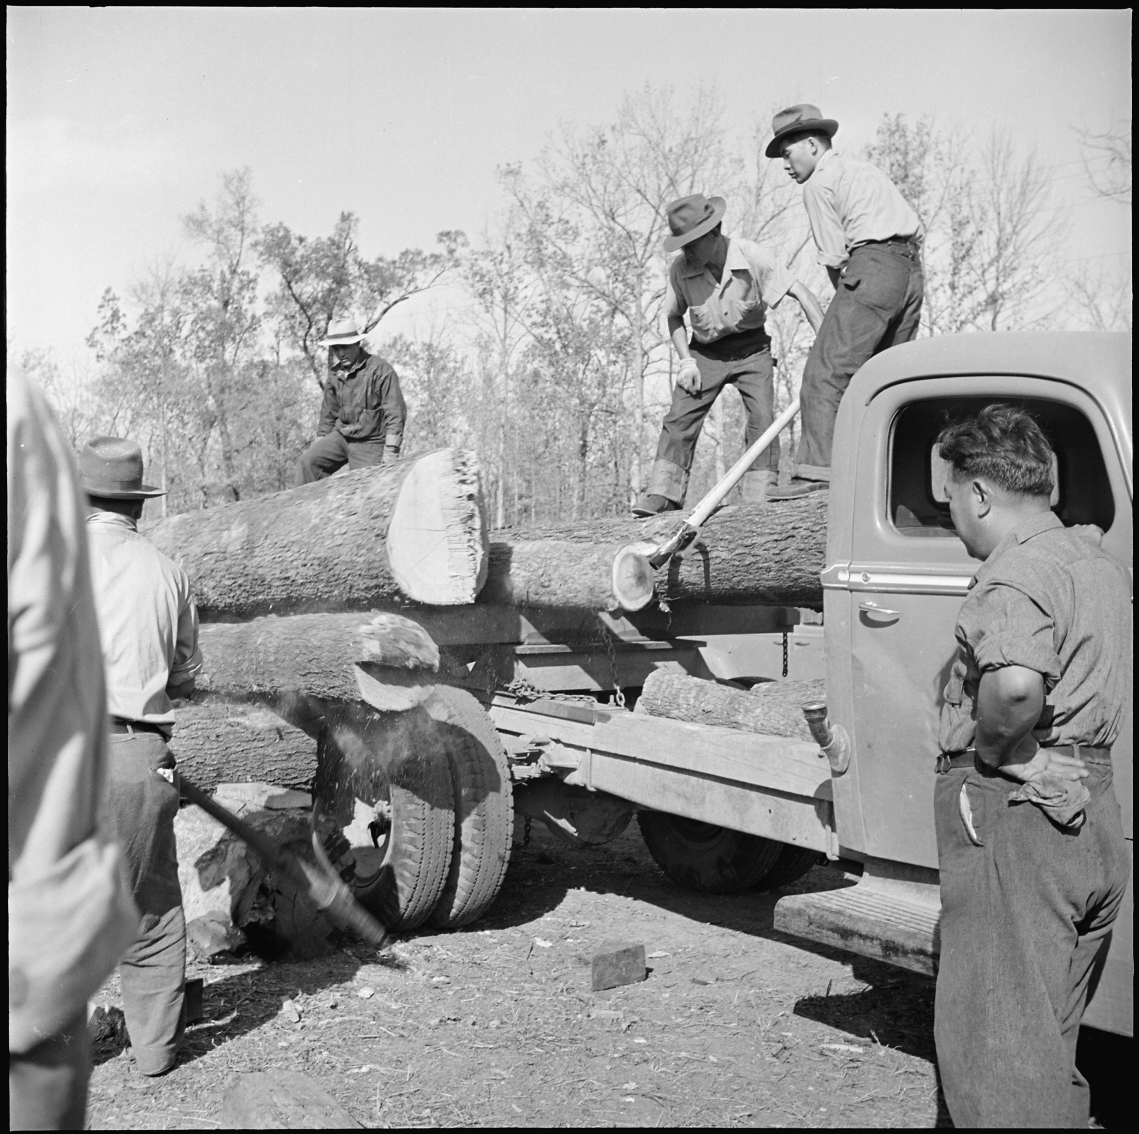
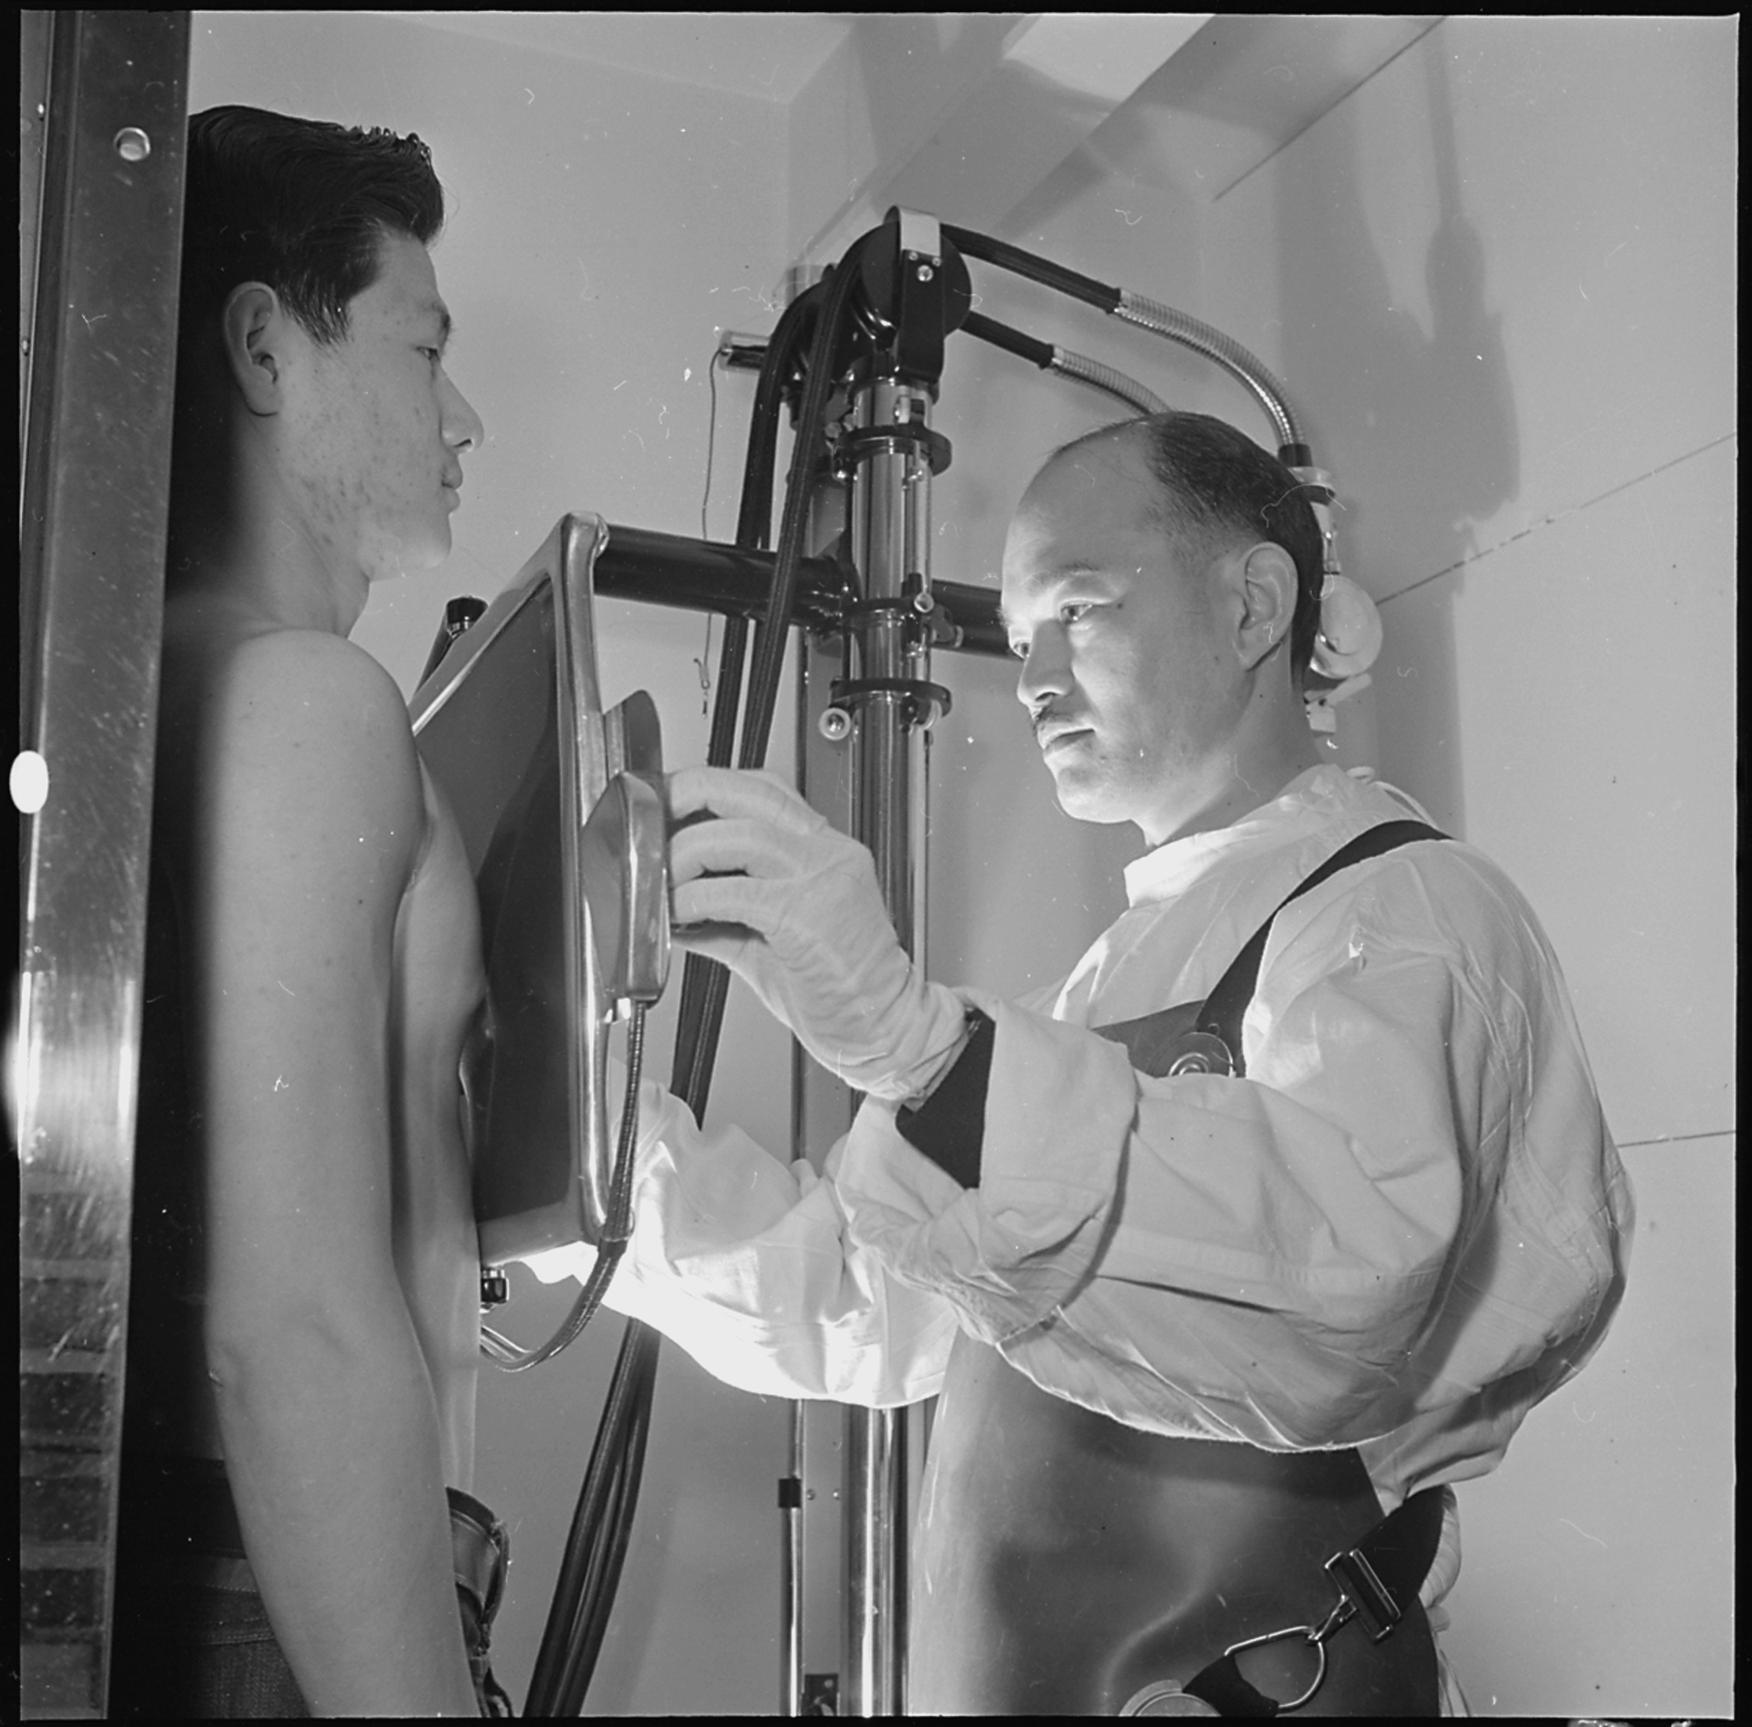
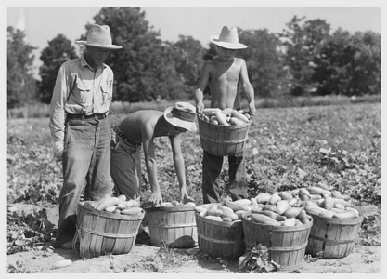
Life While Incarcerated: Employment
1942 – 1945
Many Arkansans were convinced that the camps fostered a life of leisure, but this was simply not true. The WRA created programs for "productive work" that would not be perceived as an economic threat to local industries. Most working-age incarcerees were employed by the WRA and earned $16 a month, while a small percentage in skilled positions earned $19.
Many incarcerees were put to work clearing the forested, swampy landscape to create farmland – a task that was promoted by local newspapers as a benefit to future Arkansans. Cutting trees and digging ditches was taxing and dangerous work and was therefore generally despised by incarcerees. Jobs relating to agriculture, security, consumer services, and health and sanitation were much more popular.

Slide 22
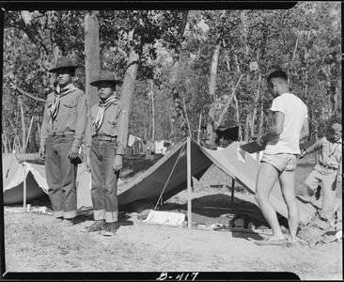
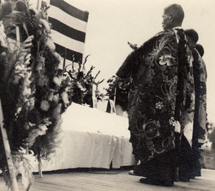
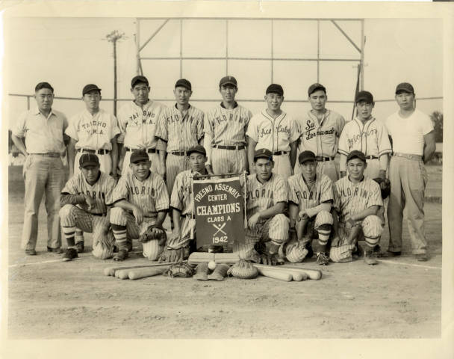
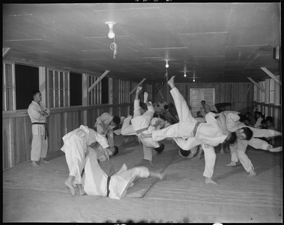
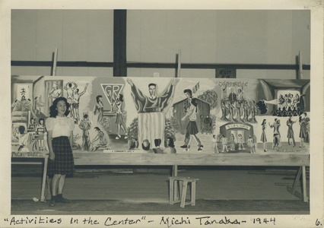
Life While Incarcerated: Enrichment
1942 – 1945
The WRA and the military police, charged with maintaining order in the camps, needed to minimize incarceree boredom and dissatisfaction. Camp newspapers were central to keeping incarcerees informed about camp rules, world and local news, and community events. The WRA led and encouraged cultural enrichment in the form of creative arts and hobbies, religious organizations, American and Japanese holidays and cultural observances, adult education programs, youth groups, and sports.

Slide 23
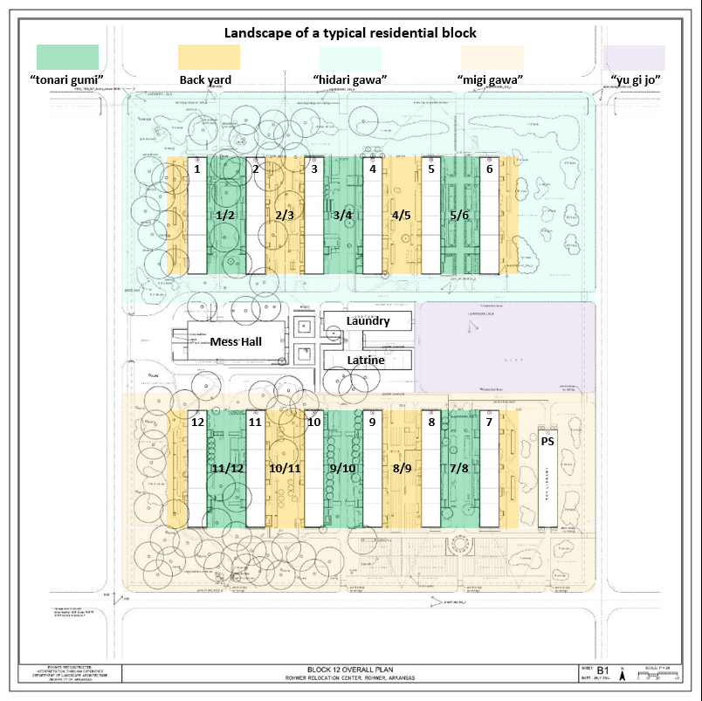

Life While Incarcerated: Community
1942 – 1945
The design of a typical residential block provided many opportunities for social interaction that fostered a sense of community, but the arrangement also strained family structures. A block had two sides divided by the mess hall, laundry/toilet building, and a public open space, creating two distinct neighborhoods. Each side contained three lanes, or tonari gumi, created by facing barracks. The block side was an area of close personal and social relations, in which visiting and cooperation on household duties between tonari gumi was common.
The central mess hall brought the entire block together several times a day for meals and served as a meeting space for a variety of other activities. Youth enjoyed the chance to eat with friends, but many parents found the loss of a family mealtime difficult.

Slide 24


Life While Incarcerated: Transformations
1942 – 1945
Arriving incarcerees faced bleak conditions. The camp was a barren and muddy mess, their one-room apartments were unfinished and barely furnished, and they were only allowed to bring what they could carry. They immediately began to improvise and improve their living conditions, scavenging scrap wood from construction sites to make shelves, interior partitions, furniture, and boardwalks. They built covered porches, awnings, pergolas, and added back doors to mitigate stifling heat and humidity. Incarcerees planted flower and vegetable gardens, particularly in the tonari gumi. In many instances, incarcerees worked together and blocks became a source of pride for both the residents and the WRA.

Slide 25


Slide 26



Jerome Concentration Camp Closes
June 1944
The closure of the Jerome War Relocation Center begins June 5 and concludes June 24. In total, 2,533 incarcerees from Jerome choose to relocate to Rohwer and the rest go to other camps. Jerome was the last camp to open and the first to close.
Rohwer welcomes Jerome incarcerees (above) as Denson High School students in Jerome say goodbye to friends bound for different camps (right).

Slide 27


POW Camp Dermott Opens
October 10, 1944
The former Jerome Relocation Center reopens as Camp Dermott, a prisoner of war camp that housed many as 5,400 Nazi soldiers and officers.
The core of Jerome Relocation Center (shown here in 1942) was reopened three months after closure as POW Camp Dermott.

Slide 28


Exclusion Policy Ends
December 17, 1944
Major General Henry C. Pratt announces that Japanese Americans can return to the West Coast beginning midnight January 2, 1945. A special edition of the Rohwer Outpost makes the announcement on December 20. Former Rohwer incarcerees who had moved to other states are the among the first to return.
Former Rohwer incarcerees return to Sacramento.

Slide 29


Rohwer Closure Announced
January 31, 1945
The closure of Rohwer and most other remaining camps is announced in the Rohwer Outpost. The closing date is set to January 1, 1946. Relocation efforts increase in Rohwer, with the majority of remaining Japanese Americans wishing to return to California.
(Right) Rohwer incarceree and WRA employee Hiroko Fujita hangs up new job offers for other incarcerees seeking relocation.

Slide 30


First Coach from Rohwer Departs for California
March 28, 1945
The first coach heading to California left Rohwer with 58 people, followed by the first train on July 26 with 417. Some incarcerees had already found other means for returning and gave positive reports. Photographs showing Japanese Americans happily resettled and working were used by the WRA to encourage reluctant incarcerees to leave the camps.

Slide 31


Atomic Bombs Dropped, Japan Surrenders
August 1945
On August 6 the U.S. drops an atomic bomb on Hiroshima, Japan, destroying the city and killing an estimated 20,000 soldiers and 70,000 - 126,000 civilians. Three days later another atomic bomb destroys Nagasaki, killing an estimated 150 soldiers and 39,000 - 80,000 civilians.
Japan's surrender was announced in Japan on August 15, followed by a formal ceremony aboard the USS Missouri on September 2.

Slide 32


Rohwer Cemetery is Completed
November 4, 1945
A 15’ tall tank-shaped concrete "Monument to the 100th Battalion and the 442nd Regimental Combat Team" honoring young men from Rohwer who lost their lives while serving in the US Army in Europe, designed and built by internee Koheiji Horisawa and assistant Harry Fujioka, is dedicated in the Rohwer cemetery. Horisawa chose to remain in camp until it closed so his work on the cemetery could be completed.
Koheiji “Kay” Horisawa
Koheiji “Kay” Horisawa (left) and Harry Fujioka pose in front of the cemetery's final monument.

Slide 33


The Last Incarcerees Leave Rohwer
November 1945
By November 2, the incarceree population of the Rohwer concentration camp was 1,790. A bus bound for Chicago left November 6 with 78 passengers, another headed to the northeastern states on November 14 with 112 incarcerees, and a third left November 20 with 41 headed to Missouri. Trains left for California on November 9 and 16 with 560 and 450, respectively. The last relocation train left for California on November 30 with 345 incarcerees at 4:43. The last 5 incarcerees departed at 6:00, one to Denver and the other four to the east and Midwest.

Slide 34




Seven Rohwer Incarceree Families Remain in Arkansas
1946+
Seven families from Stockton California decide to farm vegetables together on land leased from plantation owner George Alexander near Scott, Arkansas. Their original plan was to remain only "a few years until things settled back down in California so that hard feelings would subside," and many of them did so, but some decided to stay. The Yadas bought land in Scott and started a nursery. By 1961, twenty-three former Rohwer incarcerees or their descendants remained in Arkansas, including members of the Nakamura and Yada families. Yada family members still live in Arkansas.

Slide 35


Auctions and Transformation
1946 – 1949
Most property of the former Jerome and Rohwer camps, including land, buildings, and equipment is relocated or sold at auction. A few of Rohwer's buildings are retained and used by Desha Central Schools, including the auditorium and a part of the hospital complex.
Former Rohwer Relocation Center core, 1949

Slide 36



Rohwer Cemetery Fades from Public Memory Despite Plea on Monument
1946 – 1959
Between 1946 and 1960 only one article about the Rohwer cemetery appeared in a major Desha county or Arkansas state newspaper: “Rohwer Vanishes into the Buckshot,” December 4, 1955. Former internees and other Japanese Americans made regular visits to the site, however. During this decade the former Rohwer Relocation Center auditorium, converted for use by Desha Central Schools, was destroyed by fire. The eight murals depicting the internment experience were also lost.
“May the people of Arkansas keep in beauty and reverence forever this ground where our bodies sleep”

Slide 37






Rohwer Cemetery "Found"
1960s
“Remarkable shrines found at the old Japanese relocation area” in June 1960 by an employee of the Arkansas State Publicity Department and two officials of the American Legion Department of Arkansas, who vowed to "clean up the cemetery and maintain it as a tribute to the heroism of the Japanese-Americans in World War II." Widespread volunteer efforts are made to clean up the cemetery.
The first public memorial service was held at the Rohwer cemetery since 1945 on October 15, 1961, drawing together former internees, former WRA employees, and local residents. It was claimed to be "the first of its kind ever held at any relocation center." Periodic reunions and memorial services coincided with subsequent cleanup and preservation efforts from this time forward.

Slide 38

"Rohwer Relocation Center" Site is Listed on the National Register of Historic Places
1974
The Rohwer Relocation Center site is listed on the National Register of Historic Places despite an overall low level of historic integrity.
Photograph of the Rohwer Memorial Cemetery included in the National Register nomination.

Slide 39


Termination of Executive Order 9066
February 19, 1976
President Gerald R. Ford acknowledges that the incarceration of Japanese Americans during WWII should not have occurred and signs a proclamation confirming the termination of Executive Order 9066.
(Above) President Ford signing a proclamation confirming the termination of Executive Order 9066.
(Right) The proclamation signed by President Ford.

Slide 40


New Monument Dedicated at the Cemetery
May 30, 1982
A new monument in the Rohwer cemetery is built and dedicated, an effort led by former incarceree Sam Yada and two former WRA officials. The men were concerned that the original concrete monuments were not repairable.

Slide 41


US Government Apologizes to Japanese Americans and Makes Reparations
August 10, 1988
President Ronald Reagan apologizes to Japanese Americans on behalf of the U.S. government for incarceration during WWII and signs a bill to recompense surviving incarcerees $20,000 each. Reparation payments begin two years later.

Slide 42

Jerome Relocation Center Monument Dedicated
1988
A granite monument honoring Japanese Americans incarcerated at the Jerome concentration camp is erected near the entrance to the former camp by the Jerome Preservation Committee, spearheaded by local resident and activist John Ellington, and the Japanese American Citizen League.
John Ellington standing next to the Jerome Relocation Center monument.

Slide 43


Rohwer Cemetery Declared a National Historic Landmark
May 27, 1992
A Memorial Day service celebrates Rohwer cemetery's new status as a National Historic Landmark. In 1990, a petition to declare the entire camp as a National Historic Landmark was rejected due to lack of sufficient integrity. The event coincides with the completion of the "Rohwer Restoration Project," a former incarceree-led, multi-year effort to stabilize and renovate the cemetery.

Slide 44

Japanese American Confinement Sites Grant Program Established
December 21, 2006
Congress establishes the Japanese American Confinement Sites (JACS) grant program (Public Law 109-441) for the preservation and interpretation of incarceration sites. The law authorizes up to $38 million for the entire life of the grant program to identify, research, evaluate, interpret, protect, restore, repair, and acquire historic incarceration sites in order that present and future generations may learn and gain inspiration from these sites and that these sites will demonstrate the nation’s commitment to equal justice under the law. The program is administered by the National Park Service and begins funding projects in 2009.

Slide 45

"Jerome Relocation Center" Site is Listed on the Arkansas Register of Historic Places
August 4, 2010
The former Jerome Relocation Center site is listed on the Arkansas Register of Historic Places. Although the site has a very high level of historic significance, it lacks sufficient integrity to qualify for the National Register of Historic Places.

Slide 46



Rohwer Cemetery Documented & Conserved
Early 2010s
Rohwer Cemetery stabilization, restoration, and documentation efforts are made possible through JACS grants and collaborations between UALR, ASU, UA, CAST, non-profits, and professional firms.

Slide 47


Museum and Interpretive Exhibits Open in McGehee and at Rohwer
April 16, 2013
The "World War II Japanese American Internment Museum" opens in McGehee, Arkansas, located midway between the former concentration camp sites at Jerome and Rohwer. Interpretive exhibits are also installed at the Rohwer Memorial Cemetery.

Slide 48

Former Rohwer Relocation Center, 1949
Former Rohwer Relocation Center, 2006

Slide 49



Overview of the former Rohwer Relocation Center, 2012
The Dermott News, August 12, 1943
Overview of the former Jerome Relocation Center, 2018

Slide 50

Rising Above in Arkansas
2013 – Present

